Slide 1

MOVIE RECOMMENDATION SYSTEM USING MACHINE LEARNING
ENGINEERING WITH PYTHON PY26 BATCH – B17

Slide 2

PROJECT - MOVIE RECOMMENDATION SYSTEM USING MACHINE LEARNING
SUBMITTED BY – JAYADEV P U
TEACHER IN CHARGE – Ms. SEEMA U
DATE – 10-03-2022
Notes:
Notes to presenter:
What is your purpose for sharing this reflection?
Is it at the end of a unit or project?
Are you sharing this reflection, at the attainment of a learning goal you set for yourself?
Is it at the end of a course?
State your purpose for the reflection or even the purpose of the learning experience or learning goal. Be clear and be specific in stating your purpose.

Slide 3








PROJECT DEPENDENCIES
LANGUAGE – PYTHON
LIBRARIES – NUMPY, PANDAS, DIFFLIB, PILLOW,
SKLEARN
ML ALGORITHM – COSINE SIMILARITY
DEPLOYMENT TOOLS – GITHUB, STREAMLIT, HEROKU

Slide 4
CONTENTS
INTRODUCTION
WHAT WAS THE PROCESS ?
COSINE SIMILARITY
DATASET
DATASET PROCESSING
SOURCE CODE
PROJECT DEPLOYMENT
PROJECT PICTURES
PROJECT DETAILS
CONCLUSION

Slide 5


INTRODUCTION
Recommendation System is a system that seeks to predict or filter preferences according to the user's choices.
This Recommendation System proposes a Content Based Recommendation System and uses Cosine Similarity measure to find the similarity of movies in the dataset.
Content-based recommendation is an important approach in recommendation systems. The basic idea is to recommend items that are similar with what user liked before. It extracts keywords of the data and calculate the weight by TF-IDF.

Slide 6

COSINE SIMILARITY
Cosine similarity measures the similarity between two vectors of an inner product space. It is measured by the cosine of the angle between two vectors and determines whether two vectors are pointing in roughly the same direction. It is often used to measure document similarity in text analysis.

Slide 7
DATASET
Dataset/Source: www.kaggle.com
Structured/Unstructured data: Structured Data in CSV format.
The dataset used is ‘movies.csv’. Dataset contains over 4800 movies and 24 fields or columns.

Slide 8
Features or variables in the dataset:
'index',
'budget',
'genres’
'homepage',
'id',
'keywords',
'original_language',
'original_title',
'overview',
'popularity',
'production_companies',
'production_countries',
'release_date',
'revenue',
'runtime',
'spoken_languages',
'status',
'tagline',
'title',
'vote_average',
'vote_count',
'cast',
'crew',
'director'

Slide 9
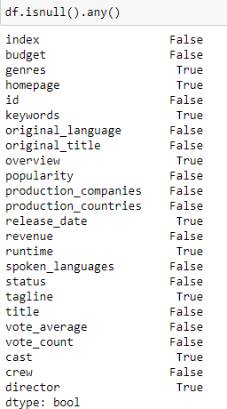

DATA PROCESSING
The movies.csv dataset contains null values, which need to be processed before feature selection.
Shape of the Dataset Finding Null Values

Slide 10

Filling the Null values in the selected features

Slide 11


Slide 13
MODEL DEPLOYMENT
The model is deployed using Streamlit and Heroku
Using streamlit we can deploy any machine learning model and any python project with ease and without worrying about the frontend. Streamlit is very user-friendly.
Heroku is a Platform as a Service (PaaS). It is a cloud platform where one can build, operate and run his/her applications in the cloud itself. Heroku, other than being a very extensive and helpful platform, offers many free plans when you create a new account on the platform. It is great for beginners who are just starting out and trying to learn model deployment to take advantage of the free plans to deploy their model on cloud.

Slide 14
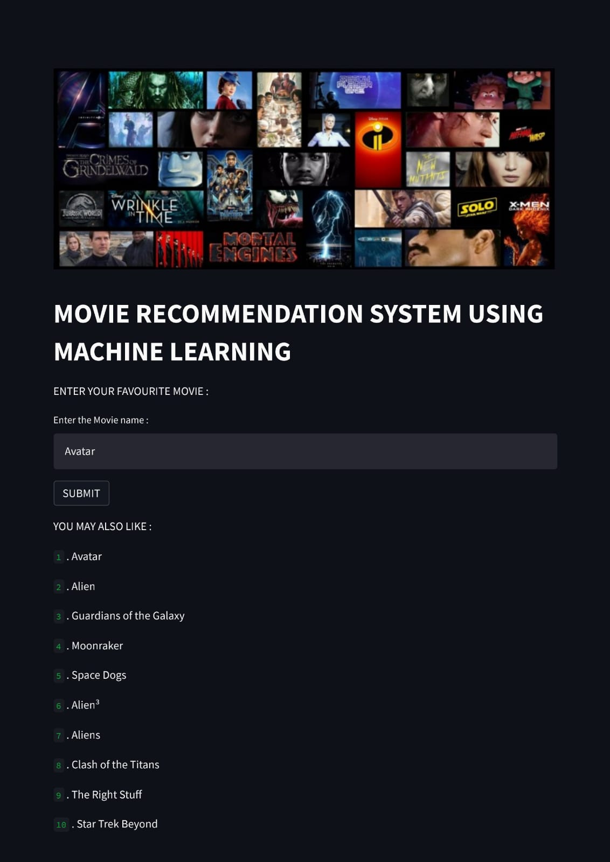
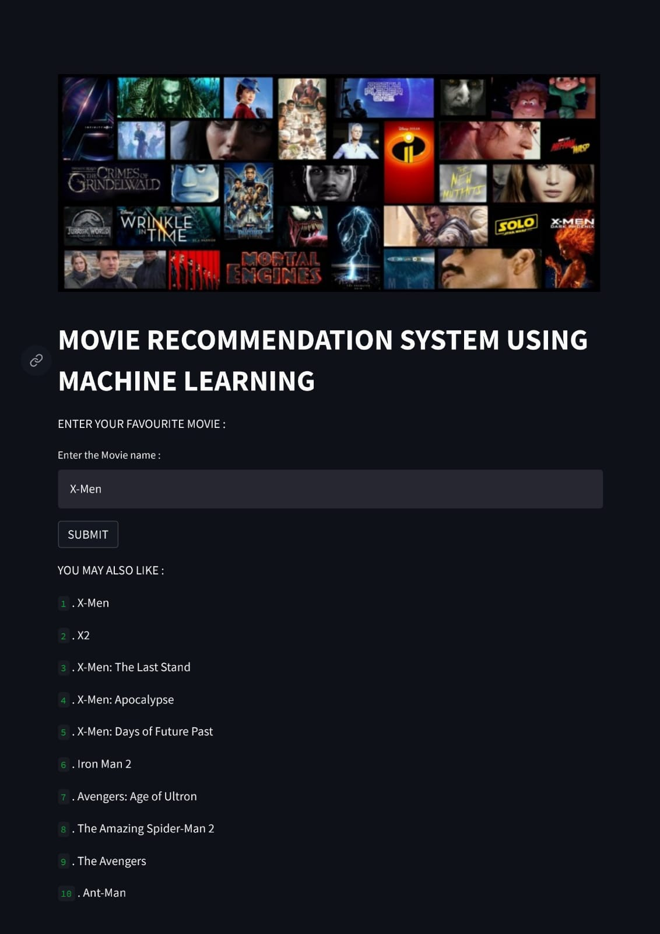

Slide 15
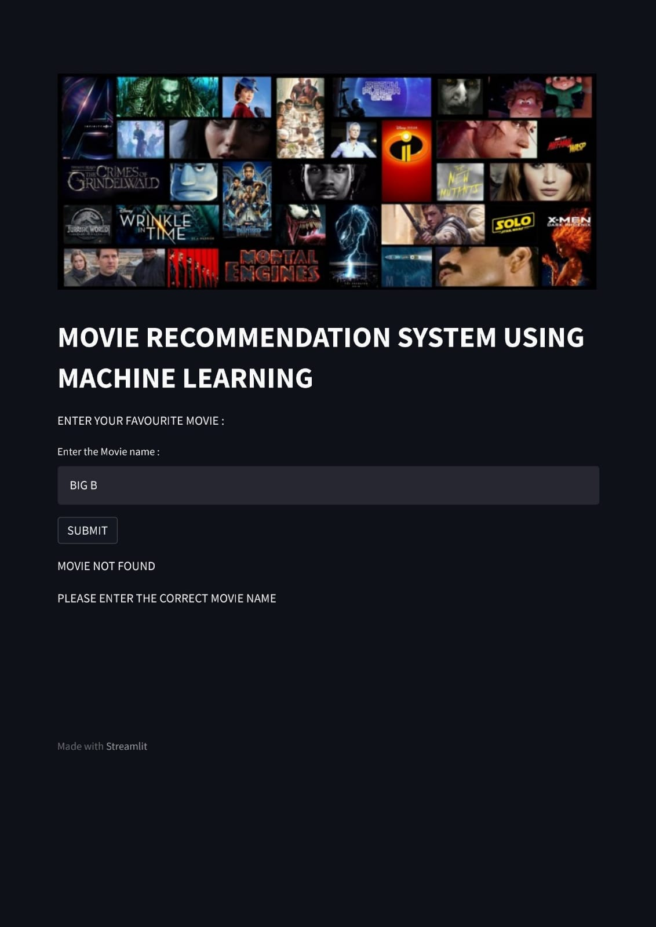

Slide 16
PROJECT DETAILS
Find the project on,
PROJECT LINK (HEROKU): https://movierecommendationusingml.herokuapp.com/
PROJECT REPO (GITHUB): https://github.com/Jayadev-3/Movie-Recommendation-System-Using-Machine-Learning.git

Slide 17
CONCLUSION
During the last years movie streaming platforms have become one of the most Internet services. Nowadays, everyone knows at least one of the biggest ones as for example Netflix. In fact, all these streaming platforms provides thousands of movies and series for all the users. But, have you ever wondered how do they recommend you the perfect movies?
The Content-based implementation achieves good results when searching for similar movies. There are plenty of way to expand on the work done in this project. Firstly, the content based method can be expanded to include more
Criteria to help categorize the movies. Often, these systems are able to collect information about a user’s choices, and can use this information to improve their suggestions in the future

Slide 18



